Slide 1
MODULE 2
Business idea and market research

Slide 2
Topic 1
SWOT ANALYSIS
SWOT analysis (also known as matrix SWOT) is a strategic planning tool used to evaluate the strengths, weakness, opportunities and threats points of a business.
The analysis covers the internal environment (the strengths and weaknesses points) and the external one (threats and opportunities).
It is important that the company knows how to evaluate the external environment and be able to explore the opportunities and threats present in the market where you want to act.
To synthesized the market opportunities, at least three aspects must be consider:
  provide an already existing product, but in a new way or qualitatively superior to the previous one;
  provide something of which there is a lack of availability;
  provide a good or service that is completely new.

Slide 3
Resource 1.1
Videos on SWOT Analysis
THIS VIDEO AS A SAMPLE ONE FOR ALL THE COUNTRIES
https://www.youtube.com/watch?v=4aFB9xrkdiU
VIDEOS FROM THE PARTNERS TO BE INTEGRATED IN THE NATIONAL VERSION OF THE MODULE

Slide 4

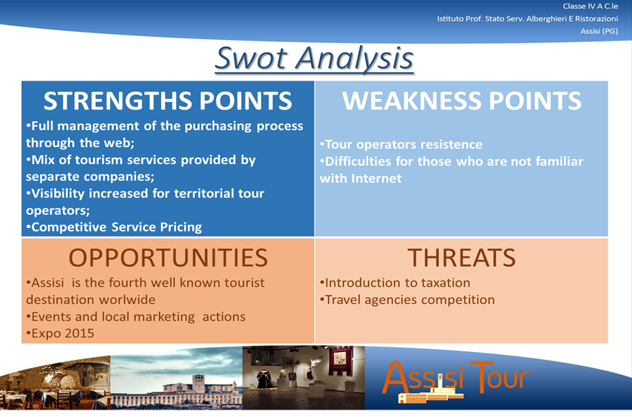
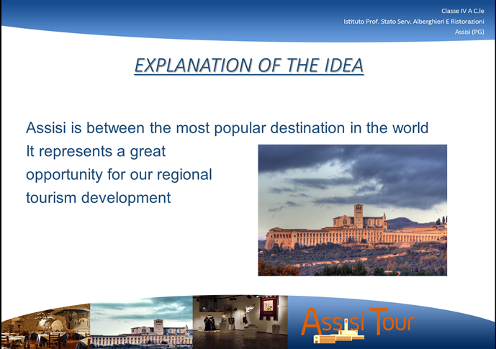
Resource 1.2a
Examples from «A scuola d’impresa»

Slide 5

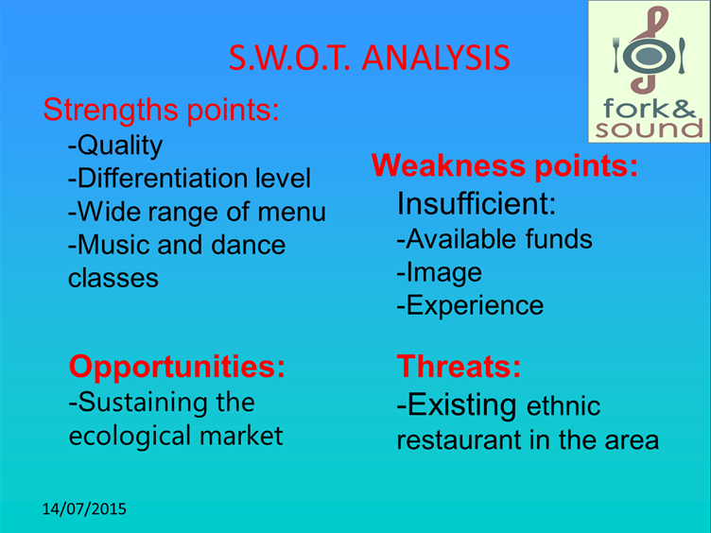

Resource 1.2b
Examples from «A scuola d’impresa»

Slide 6
Activity 1.1 (online)
Preliminary Research
Description: Let’s start putting the basis for your market research? Is your business idea useful for the target group? Is it innovative?
Instructions for the students: Try to locate the main aspect that makes the business unique, or at least more attractive than your competitors. Click here to open ‘Google maps’ and digit the keyword that better qualify your business idea in the search field. Now, you may have an idea of similar companies around you… visit their website and try to list 10 reasons of why a costumer should choose your product / service.
Interaction with the platform: students have to fill 10 numbered comment fields and can later download their answers.

Slide 7
Activity 1.2 (online)
What resources do you need?
Description: Now that you have checked also the website of your possible competitors, you should be more aware of the resources that you need.
Instructions for the students: Fill the table below with all the requested information!
Resources | Description of resources needed | Resources current availability
Technological Resources |  | YES (provide details) | NO (ideas for acquiring the resources)
Human Resources |  | YES (provide details) | NO (ideas for acquiring the resources)
Financial Resources |  | YES (provide details) | NO (ideas for acquiring the resources)

Slide 8
Activity 1.3 (online)
My personal swot analysis
Description: Following the examples and the information that you have received in the previous sections of the platform, you should be able to implement a swot analysis of your business idea.
Instructions for the students: Think at the strengths and weaknesses points, opportunities and threats of your product/service and fill the table below with, at least, three elements for each box!
STRENGTHS POINTS | WEAKNESSES POINTS
OPPORTUNITIES | THREATS

Slide 9
Topic 2
The market research
Now, is the time to integrate and deepen what has been done so far. First, by making a comparison with our markets to raise additional and important information trough a proper market research.
Marketing research is a systematic collection and analysis of data aimed at identifying market information of a particular good and/or service.
Weather the activity is starting or has been already undertaken, market surveys are a major source of information that companies and organizations use to decide which products and/or services can be offered to the public, and how to market them.
The four main areas of study - Product, Sales, Promotion and Consumer - are closely interrelated.
Product research: involves new products development and testing, improvement of existing products on the market, and the likely changes in consumer preferences.
Sales research: involves a comprehensive examination of all company’s sales activities.
Promotion research: concerns the analysis and evaluation of the effectiveness of various methods used to promote a company’s products and services.
Consumer research: concerns surveys on consumer behavior to study the social, economic and psychological factors that influence buying decisions.

Slide 10
Resource 2.1
Videos on Market Research
THIS VIDEO AS A SAMPLE ONE FOR ALL THE COUNTRIES
https://www.youtube.com/watch?v=2X-QSU6-hPU
VIDEOS FROM THE PARTNERS TO BE INTEGRATED IN THE NATIONAL VERSION OF THE MODULE

Slide 11
Activity 2.1
The plan for my market research
Description: Based on what you have read and learned so far, try to describe your research design.
Instructions for the students: Refer to the following useful Topics in case you are not able to define all the stages; you will finish the compilation later.
RESEARCH PHASES | DESCRIPTION
Research problems and objectives definiton
Research plan development
Information collection
Analysis and processing of data
Results presentation

Slide 12
Topic 3
The questionnaire
The questionnaire is undoubtedly one of the most used tool for collecting primary data. The construction of a questionnaire requires decisions on certain "key" aspects, including:
identify the issues interested for an investigation and the principal variables to be analyzed in relation to them;
know the reference’s frame on which you formulate the questions;
plan the question wording;
determine the questions’ sequences and questionnaire’s length.
The questionnaire can be administered via different types of interactions techniques: personal encounter (face-to-face), contact telephone, postal and online.
Questionnaire’s types of questions
Open: allows to answer in unstructured way, you would use it when you need a numerous list of options or when you do not want in any way to influence the answer.
Closed: reduces discretion of the response’s transcript and promotes elaboration process.
Filter: directs the respondent to the next questions
Control: favor the identification of answers in contrast between them.

Slide 13
Resource 3.1
Videos on How to make a questionnaire
THIS VIDEO AS A SAMPLE ONE FOR ALL THE COUNTRIES
https://www.youtube.com/watch?v=HfGyiRBwSec
VIDEOS FROM THE PARTNERS TO BE INTEGRATED IN THE NATIONAL VERSION OF THE MODULE

Slide 14
Resource 3.2a
Examples of questions types
What do you give more importance when choosing a hotel? (open question) …………………………………………………………………………………………………
What do you give more importance when choosing a hotel? (It follows a series of possible answers, from the beginning must be established weather you can give more than one answer – close question)
1) Price
2) Cleaning
3) Services
4) Location
5) D
6) F
7) G
Other (please specify)…………………………………………………….
Do you plan to use a service like this?
Certainly yes
Probably yes
I don ‘t know
Probably not
Certainly not
How much do you like this product?
Very much
A litte bit
Not very much
Not at all
I don’t know how to express an opinion

Slide 15
Resource 3.2b
Examples of question types
The customer service has disappointed or exceeded your expectations?
Disappointed expectations Exceed expectations
5 4 3 2 1 0 1 2 3 4 5
How important is it for you …. ? (1=not at all; 5=very much )
The room’s lighting 1 2 3 4 5
The room’s silence 1 2 3 4 5

Slide 16


Resource 3.3
Examples from «A scuola d’impresa»
Click here to download a full example of a market research questionnaire.

Slide 17
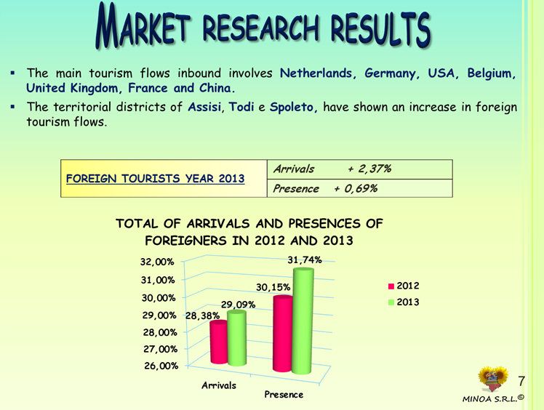
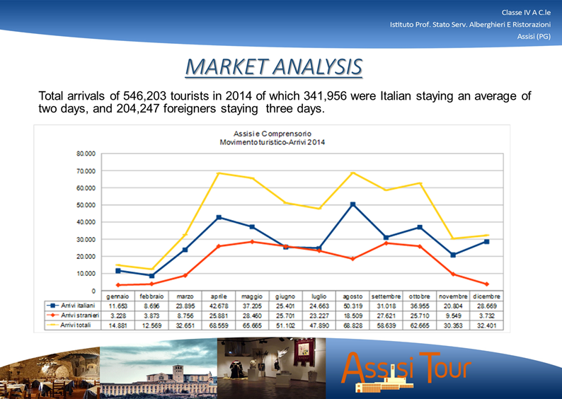
Resource 3.2a
Examples of market research
Example of a market research proposed by some of the participants who took place on the ‘Business at School’ project third edition ( www.scuolaimpresa.net).

Slide 18
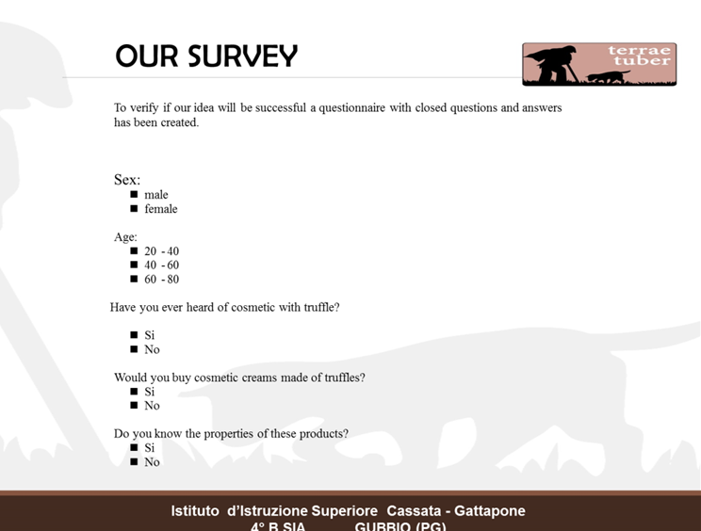
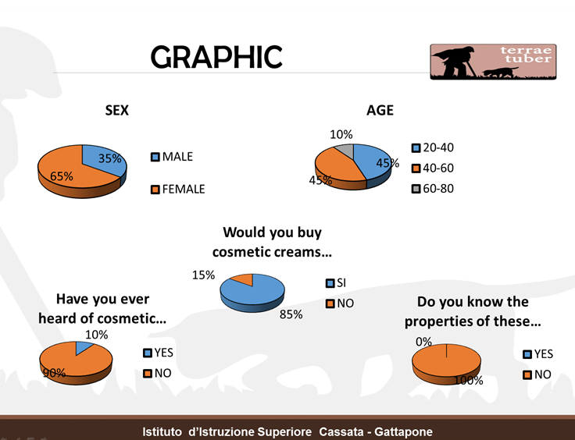
Resource 3.2b
Examples of market research
Example of a market research proposed by some of the participants who took place on the ‘Business at School’ project third edition ( www.scuolaimpresa.net).
www.scuolaimpresa.net).

Slide 19
Final activity of the module
Group workshop to be held at school
Guideline for teachers
Before organizing the final activity of Module 2, make sure that all the students have completed the online activities and related exercise.
Ask them to download the answers provided during the online module.
The final activity should be carried out by the same sub-national teams that are working with the 4 different transnational business ideas.
Support the students in the interaction with the market’s and community’s representatives. If possible, arrange a short round table where the team leaders present the business ideas in order to get feedback and suggestions.
The final aim is that each national sub-group conduct a market research on the transnational business idea identified during the Slovenian meeting in October. The results and reports produced by the national sub-groups will be used for the workshop in Greece in January 2016.

Slide 20
Final activity of the module
Activity n.1 – Planning the market research (4 hours required)
Ask the students to compare the results of the exercises carried out in module 2 (each students present the results to the rest of the group) – 1 hour
The group create a promotional leaflet of their transnational business idea paying attention to the main target group of their product / service – 1 hour
TIP FOR TEACHERS: even though this is an activity that will be carried out in module 3, encourage the students to create a first version of the logo... it will be useful for the meeting in January 2016.

Slide 21
Final activity of the module
Activity n.1 – Planning the market research (4 hours required)
Each national sub-groups identify the main strength and weakness of their product / service in a poster to be shared and integrated with the comments of the other students – 1 hour
An online questionnaire for the research is created including 10 questions to confirm the strength and weakness points, as well as an assessment grid of the business idea based on the following aspects:
  Originality/Differentiation
  Innovation
  Saleability
  Competitiveness
  Feasibility
  Profitability
  Functionality
TIP FOR TEACHERS: links to online services for questionnaires will be provided.

Slide 22
Final activity of the module
Activity n.2 – Implementation of the market research (homework activity – 12 hours)
Each group independently administrate the questionnaires to the selected target following the strategy that they prefer. Anyway, all the data need to be finally inserted in the online questionnaire by the students. Printed copies of the promotional leaflet and the questionnaire will be provided by the school.

Slide 23
Final activity of the module
Activity n.3 – Preparation of the final reports (classroom activity – 4 hours)
Preparation of an introductory paragraph on the economic sector and the information received by the market’s representatives – 1 hour
Preparation of the paragraph on the planning and implementation of the market research – 1 hour
Download of the analysis report with the results of the questionnaires and confirmation of the strength and weakness points – 1 hour
Finalization of the presentation to be shared with the other members of the transnational business groups in occasion of the mobility – 1 hour

Slide 24
Meeting in January 2016
The main aim of the transnational mobility will be the comparison of the results obtained in each country with the activities carried out in module 2 and the selection of the country where the company will be open. It is advisable that the Administrative directors of each national sub-groups participate in the meeting. If a school wants to bring additional students, we suggest you to choose the Marketing manager. A detailed description of the workshop’s activities will be prepared and circulated among the partners in December 2015.
When the students go back school, a final group activity should be organized in order to present the results of the mobility and the final asset of the transnational business ideas.

