Slide 1
MODULE 3
Communication strategy

Slide 2
Topic 1
The importance of communication
A business that does not communicate is intended to die. The company sends messages to the world in order to be know by potential users/clients and to stimulate the demand for its product and/or service.
Business communication is an essential tool to enhance the company’s identity and image on the market, to obtain credibility, trust and legitimacy that may attract those necessary resources for a long-lasting success.
Communication can elaborate inputs that relate to the rational sphere (informative and technical communication) and to the emotional sphere (maximum emphasis on symbolic values, looking for involvement and complicity with the target)
Companies are increasingly promoting themselves through a polyhedral amount of communication tools, each of which is suitable for achieving particular set of objectives and targets

Slide 3






Activity 1.1 (online)
Effective communication
Description: To communicate in an effective way, it is necessary to ask yourself:
  To whom I communicate?
  What am I communicating?
  Which channel am I using?
  Who are my competitors?
  When am I communicating?
  What is my budget?
Instructions for the students: select the graphic element that best fit with the key questions of an effective communication plan.
Interaction with the platform: students are able to drag and drop graphic elements from a general besides each of the questions listed in the activity. When they submit the activity the results is given and, if some wrong answer has been provided, they have the chance to repeat the activity.

Slide 4


Topic 2.a
Slogan and logo
When you have chosen the name of your company, it is important to conceive a SLOGAN, a short sentence that “enhance” the name and, sometimes, is integrated with the logo.
The most important iconic part of the brand is the LOGO, a mixture of typographic and figurative elements that, together with the name, qualify the company and the main offered products and/or services.
I would suggest to include one international logo and a national one. Please, provide Jose with an example for your respective countries

Slide 5
Topic 2.b
Slogan and logo
The company’s logo contributes to set up the business identity through the use of colors, symbols and characters, and permits to differentiate it in the eyes of the consumer and its major competitors
Its importance relies in being recognizable and transmit at a glance the real essence of the activity carried out by the company.
Design and managing the slogan and the logo, the main characteristics should
  Simple
  Distinctive (perceived as different)
  Memorizable (easy to recognize and remember)
  Meaningful (capable to facilitate a correct and effective setting up of brand associations, related to the category of offered product or service, or able to promote clear messages on users’ benefits)
  Coherent (with the selected positioning)
  Flexible (medium and long-term capacity of adaptability)
  Protectable (from the legal and competitors’ point of view)

Slide 6

Resource 2.1a
Examples from «A scuola d’impresa»
Our logo comes from the merger of two English words, ALTERNATIVE and TOBACCO.
The two abraviations (ALT and TOB) share the letter T, which we made bigger and decorated with the tobacco plant’s leaves, represeting the core of our project.
We have decided to use an olive green color, tending to dark, a coloration that directly recalls the tobacco leaf, and the use of natural materials.
The message behind the logo is THE ALTERNATIVE USE OF TOBACCO.

Slide 7

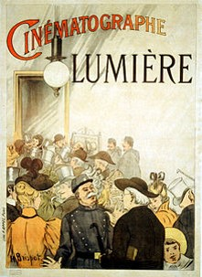
Resource 2.1b
Examples from «A scuola d’impresa»
We decided to call our cinema "Lumiere" in honor of Auguste Marie Louis Nicholas and Jean Louis Lumière brothers who in 1895 invented the "Cinematograph". The first movie was shot with this new technique on March 19, 1895; it was "Workers Leaving the Lumière Factory".
With the Lumière brothers in 1895 we can start to talk about cinema itself, consisting of a show projection of photographs (the first projected on December 28, 1895 in the basement of a building in Paris) taken in quick succession, so to give the illusion of movement, to a paying audience gathered in a hall.

Slide 8
Resource 2.2
If you need an idea for a logo online
Patents and trademarks
Logo of the day is a website that awards the best logos examples from all over the world.
Brands of the world is the biggest collection of logos that is possible to download also in vectorial format.
Logomoose offers a selection of creative and original logos.
Logofaves is constantly surfing the portfolios of online designers and it catalogues the best logos.
Link to the patents office/service of your country
European office for the harmonization of the internal market
WIPO – World Intellectual Property Organization (for international trademarks)

Slide 9


















Resource 2.2
Colors symbolism
RED | BLUE | GREEN | YELLOW | WHITE | GOLD/ SILVER | ORANGE | PURPLE | GRAY | BLACK
Force Passion Power Prohibition Danger Virility Courage Action | Peace Virtue Immateriality Meditation Wisdom Dreamy Trust Goodness Quiet Safety Faith Femininity | Hope Nature Immortality Rest Faith Youth Fertility Satisfaction Quiet | Science Awareness Idealism Action BrightnessPride Jealousy Quiet Security | Purity InnocenceChastity Wealth Silence | Immortality Wealth Glory (Gold) Respect (money) Dignity (silver) | Energy Ambition Enthusiasm Imagination Wealth Honor | Courtesy Jealousy Mystery Spirituality Melancholy Sadness Modesty Religion Unconscious Secret Darkness Death Piety Noblesse | Sobriety Sadness Modernism Fear Monotony | Dead Mourning Night Mystery Monotony Sadness Distress Anxiety Noblesse Distinction Elegance Silence

Slide 10
Activity 2.1 (online)
My favourite logos
Description: Think at your favourite logos and brands. Have you ever thought at the reasons why these companies have chosen a particular and predominant colour for their logo?
Instructions for the students: Upload the logos of your favourite brands according to their predominant colour and briefly explain, in your opinion, why the company choose this particular colour. Remember that there are not right or wrong answers, so don’t google it and express your personal opinion.
Interaction with the platform: coloured boxes are presented and named one after the other (based on the list in the previous slide). For each colour, students can upload an image from their desktop or from a link and they have to fill a comment field by following the instructions given in the activity.

Slide 11
Activity 2.2 (online)
Now it’s time for my logo
Description: Having in mind all the information already collected for your transnational business idea, try to design a simple version of the logo for your team’s product or service.
Instructions for the students: It is not important how you do it, but “just do it” ☺. You can use coloured pencils or a graphic design software (did you know that there are a lot of open source software online for this? For example: GIMP, OnlineLogoMaker, DesignMantic and many others). Be sure that your logo respects all the criteria described in topic n.2 and when you are finished upload it here in the platform, together with a brief explanation.
Interaction with the platform: as for the previous activity, students have to upload an image and to provide a description before proceeding with the module.

Slide 12
Topic 3
The marketing plan
Marketing communication helps to develop brand awareness, which means that consumers translate product information into perceptions about the product’s attributes and its position within the larger market. Businesses also use marketing communication to retain the product’s current customer base, and to cement relationships with customers and suppliers, notes "Reference for Business." Marketing communication strategy defines the business’s plan for product information dissemination and brand awareness development.
Design an effective marketing communication strategy with one or more marketing communication components. Advertising allows a business to reach a large audience through mass market or target market appeals. Personal selling enables a company to communicate product benefits directly to the customer, as in a retail setting. Direct marketing permits a business to reach customers without a third party medium; examples include catalogues and direct mail. Sales promotion provides a customer with an incentive to buy the company’s product, such as a company that makes a charitable contribution with each sale. Public relations involves a company’s outflow of information to customers, suppliers and other groups affected by company operations.

Slide 13


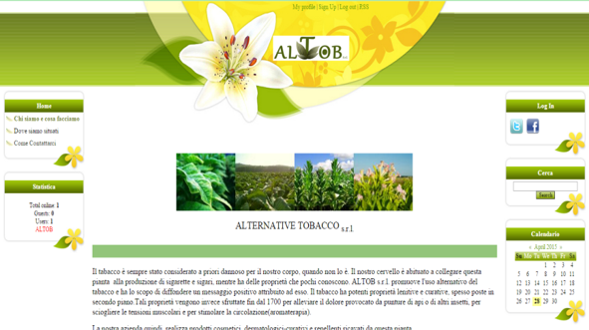
Resource 3.1a
Examples from «A scuola d’impresa»
ALTOB publicity strategy
We have decided to promote our product through:
Distribution of leaflets in shops and retail
The company’s website (http://altobsrl.ucoz.com/)
Facebook and Twitter pages, especially due to the rapid dissemination of news through the social networks
A dedicated advertising campaign in Facebook

Slide 14
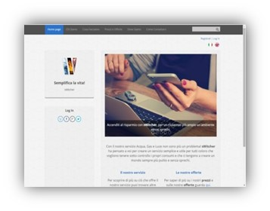

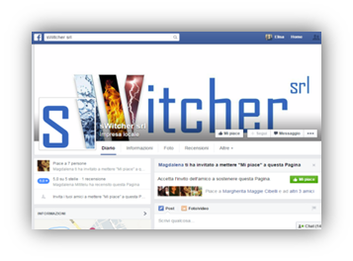
Resource 3.1b
Examples from «A scuola d’impresa»
SWITCHER publicity strategy
We have decided to promote our product through:
A website, because important for the request and the use of our service
A Facebook page due to the large use of social networks
An advertising spot, realized by us, to easily enter in families’ houses
Leaflets, posters and banners

Slide 15
Resource 3.2
Videos on Inspiring promotional campaigns
Links to videos in English
  Coca-Cola and prejudices
  Apple and family feeling
  Funny commercial
VIDEOS ON NATIONAL COMMERCIALS TO BE INTEGRATED IN THE PLATFORM BY THE PARTNERS

Slide 16
Final activity of the module
Group workshop to be held at school
Guideline for teachers
on the basis of your internal resources and/or opportunities for external collaboration, each country could concentrate in the implementation of a workshop focused on one specific aspect of the communication strategy, such as: the logo and graphic identity, website development, social network, innovative marketing, etc… (this aspect can be better defined in 2016).
The workshop activity will be agreed on the basis of the internal agreement between school. The members of the transnational business groups will cooperate in order to prepare a presentation for the meeting in Holland that will include all the aspects of the communication strategy.

Slide 17
Meeting in March 2016
The main aim of the transnational mobility will be the final analysis and improvement of the business ideas, with a specific focus on social marketing and the selection of the logos/visual image of the company. It is advisable that the meeting is participated by the Communication directors of each national sub-groups. If a school wants to bring additional students, we suggest you to choose the Marketing or Product/operation manager. A detailed description of the workshop’s activities will be prepared and circulated among the partners in February 2016.
When the students go back school, a final group activity should be organized in order to present the results of the mobility and the improved version of transnational business ideas.

